Slide 1
Web Applications CT050-3-2 (VD1)
Introduction and Overview

Slide 2
Lecturer information
Lecturer Name: Sathiapriya
Email: sathiapriya@staffemail.apu.edu.my

Slide 3
Pre-requisites for this module
None

Slide 4
Aims of this module
The aim of this module is to introduce web development concepts. This is followed by introduction of tools used to develop web applications for both client and server environments. Tools involving scripting and database handling are covered. Concepts related to good design, usability, and maintainability of web pages are taught in the syllabus.

Slide 5
Course Learning Outcomes
At the end of this module, YOU should be able to:
Explain the important concepts and their application in designing and developing web application.
Develop a web application which is connected to a well-designed database by using server and client side scripting language based on the current web standards
Explain the design and solution which provide a systematic way to develop web application.

Slide 6
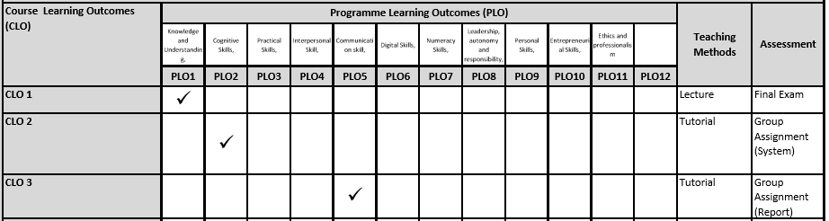
Mapping of CLOs with MOEs Domain
PLO1 – Knowledge and Understanding
PLO2 – Cognitive Skills
PLO5 – Communication Skills

Slide 7
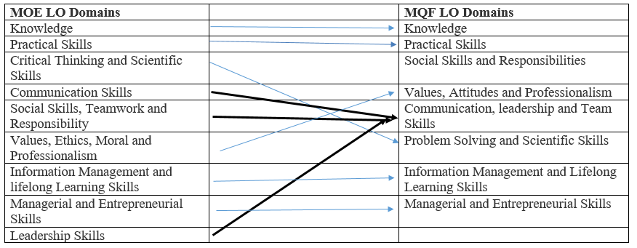
MQF and MOE Domains

Slide 8
Teaching Strategies
Tutorial
Lab

Slide 9
Assessment Method
Group assignment 50%
Hand out Hand in
Week 3 Week 13
Final Exam 50%

Slide 10
Student Learning Time (SLT)
Module Credit Value: 3
Total Learning Hours:
Guided learning (F2F)
Tutorial: 28 hours
Lab: 28 hours
Independent learning (NF2F)
41 hours

Slide 11
Methods of Delivery
Hence,
We are now moving from the traditional topic based teaching to outcome-based education

Slide 12
Outcomes Based Education (OBE)
OBE is education based on producing particular educational outcomes that:
Focus on what students can actually do after they are taught
Expect all learners / students to successfully achieve particular (sometimes minimum) level of knowledge and abilities.

Slide 13
So…What is OBE?
It’s
NOT
What we want to teach,
It’s
What You should learn

Slide 14
Course Content Outline
CLO1 : Final Exam (50%)
Lecture : Introduction to Web Development
Lecture : Methods for Web Page Design
Lecture : Introduction to ASP.Net
Lecture : Servers and Security
Lecture : Evaluation of Web Pages
Lecture : Web HCI and Usability
Lab Activity 1 : Derive design diagrams
CLO2 & CLO 3 : Assignment (50%)
Lab Activity 1: CRUD and authentication
Lab Activity 2 : Proposal & Design

Slide 15
What is expected of you
What is expected of you
You should abide to all the rules & regulation of APU
Proper attire
No speaking of dialects
Attendance is compulsory and valid medical certificates or letters from parents /guardians must support any absence from class.
Three lateness will be equal to one absence
All handphones should be turned off during lectures.

Slide 16
What support is available for you
Consultation hours
Resources
Reference material
Dresher, T., Zuker, A. and Friedman, S. (2018). Hands-On Full-Stack Web Development with ASP.NET Core: Learn end-to-end web development with leading frontend frameworks, such as Angular, React, and Vue. 1st ed. Packt Publishing. ISBN : 978-178862-288-2
Aroraa, G. and Dash, T. (2018). Building RESTful Web Services with .NET Core: Developing Distributed Web Services to improve scalability with .NET Core 2.0 and ASP.NET Core 2.0. Birmingham: Packt Publishing. ISBN : 978-1788291576
Troelsen, A. and Japikse, P. (2017). Pro C# 7: With .NET and .NET Core. 8th ed. Apress. ISBN: 978-1484230176
Internet resources

Slide 17
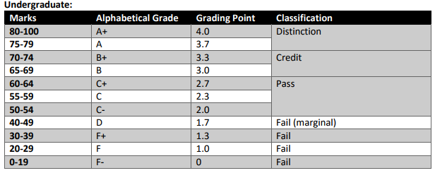
Achievement requirements

Slide 18
Question and answer session
Q & A

Slide 19
What we will cover next
HTML5

